Slide 1

Submitted By:
Gourav Goyal
goyal.gourav1999@gmail.com
8949780391 Business Analyst Career Program – Bacth 12
Business Analyst Career Program - Capstone Project

Slide 2

Agenda
Data Exploration
Statistical Analysis using Excel
Graphical Analysis using Excel
Insert the given data into the SQL server
Import the Data from the SQL Database into PowerBI
Interactive Dashboard by using visualization tools
Conclusion and Inferences
Endnotes

Slide 3
Data Exploration
This dataset contains information about sales transactions across different segments, countries, products, and discount bands.
Segments: The dataset includes various segments such as Government, Midmarket, Channel Partners, Enterprise, and Small Business.
Countries: Sales data is recorded for countries including Canada, Germany, France, Mexico, and the United States of America.
Products: Different products like Carretera, Montana, Paseo, Velo, and VTT are listed.
Discount Bands: Transactions are categorized into different discount bands, including None and Low.
Sales Metrics: Information on units sold, manufacturing price, sale price, gross sales, discounts, sales, cost of goods sold (COGS), and profit is provided.
Date: Transactions are recorded with specific dates, month numbers, month names, and years.
Overall, this dataset provides a comprehensive view of sales performance across different segments, countries, and products, along with associated financial metrics and discounting strategies. Analyzing this data could reveal insights into sales trends, profitability, and the effectiveness of discounting strategies in various market segments and countries.

Slide 4
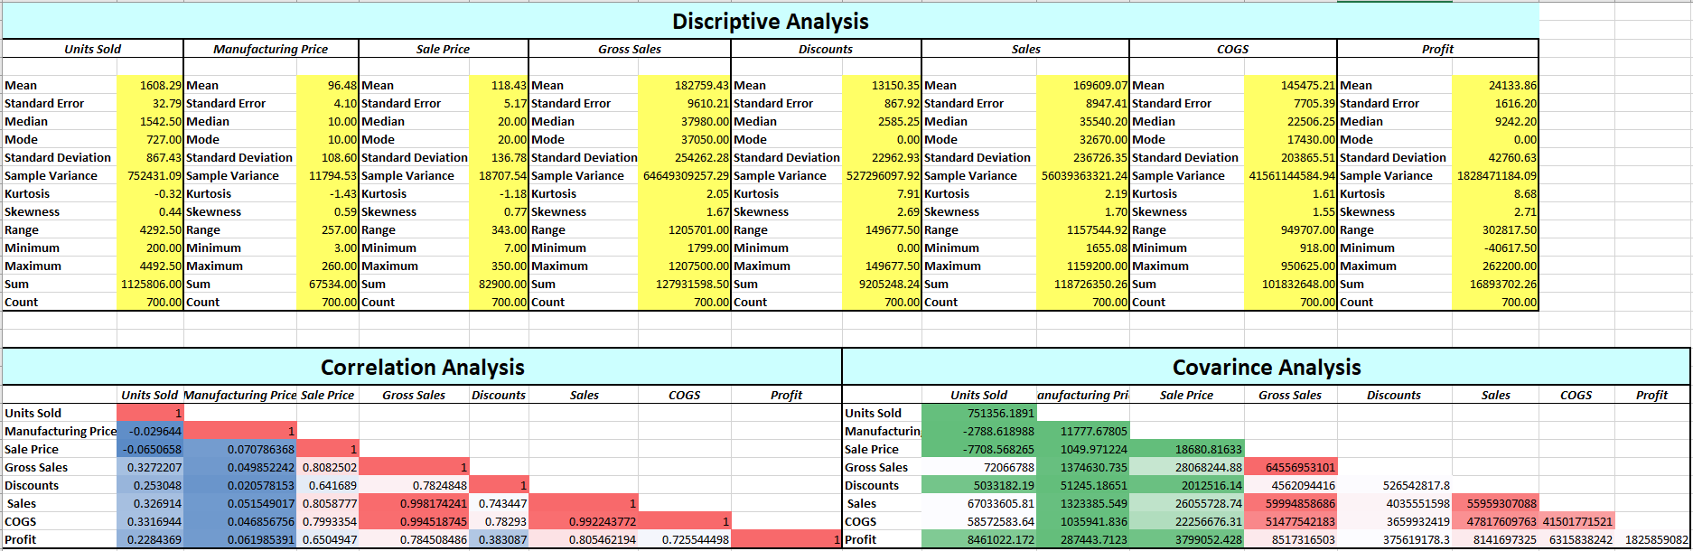
Statistical Analysis using Excel
Data Cleaning Performed:
Checked Duplicates and Blanks records
Changes data types and corrected the row and column format
Statistical Analysis using EXCEL:

Slide 5
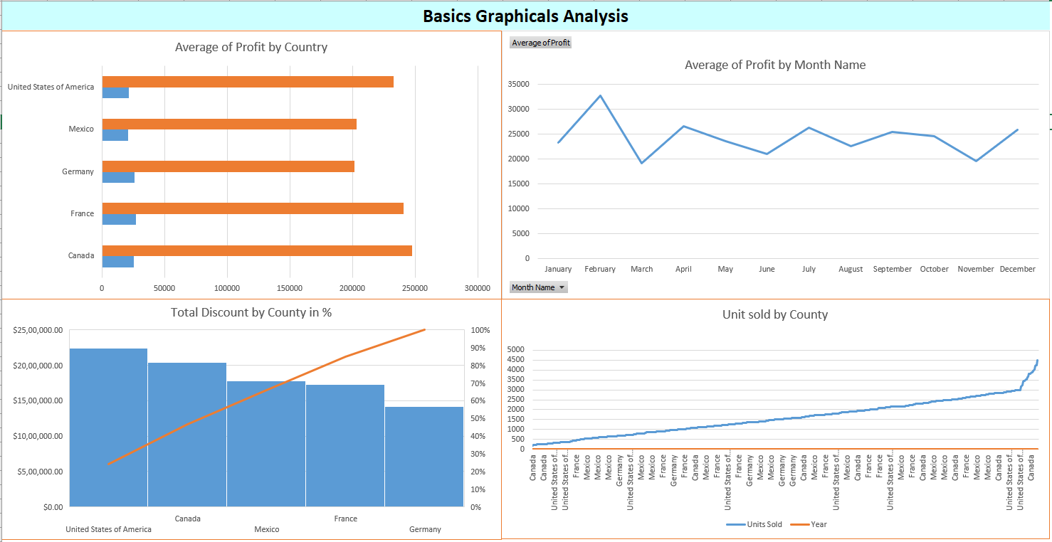
Graphical Analysis using Excel
To perform graphical analysis on the given data using Excel, we can create various types of charts and graphs to visualize different aspects of the dataset. Here are some insights we can derive from the data through graphical analysis:
By performing these graphical analyses in Excel, we can gain valuable insights into the dataset, such as identifying sales trends, evaluating profitability, understanding the impact of discounts, and comparing performance across different segments and products. These insights can guide business decisions and strategies to optimize sales and maximize profits.

Slide 6
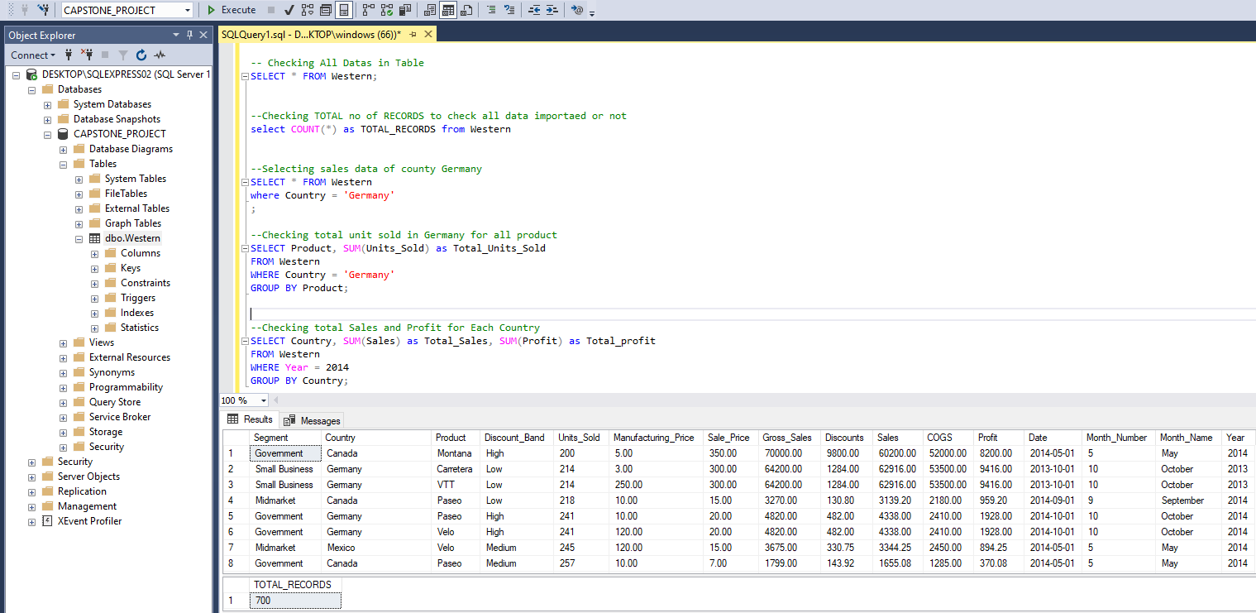
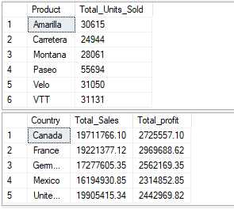
Insert the given data into the SQL server
Create a database called CAPSTONE_PROJECT, import Excel data into it, and verify that the total number of records found is 700, which is correct. All data has been imported correctly. Below are a few basic commands to find sales and profit.

Slide 7
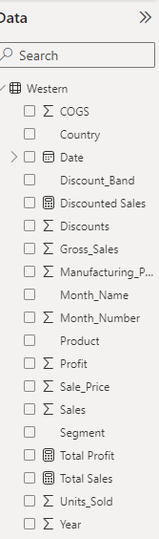
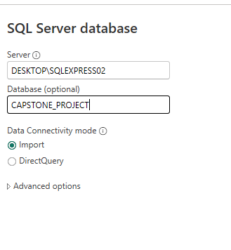
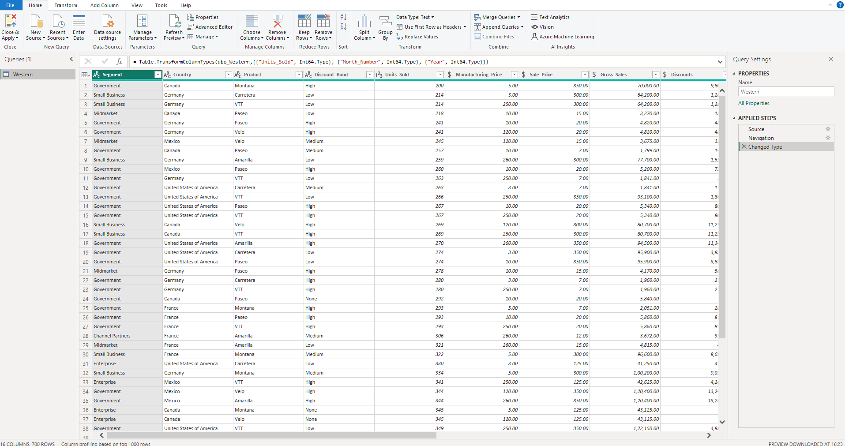
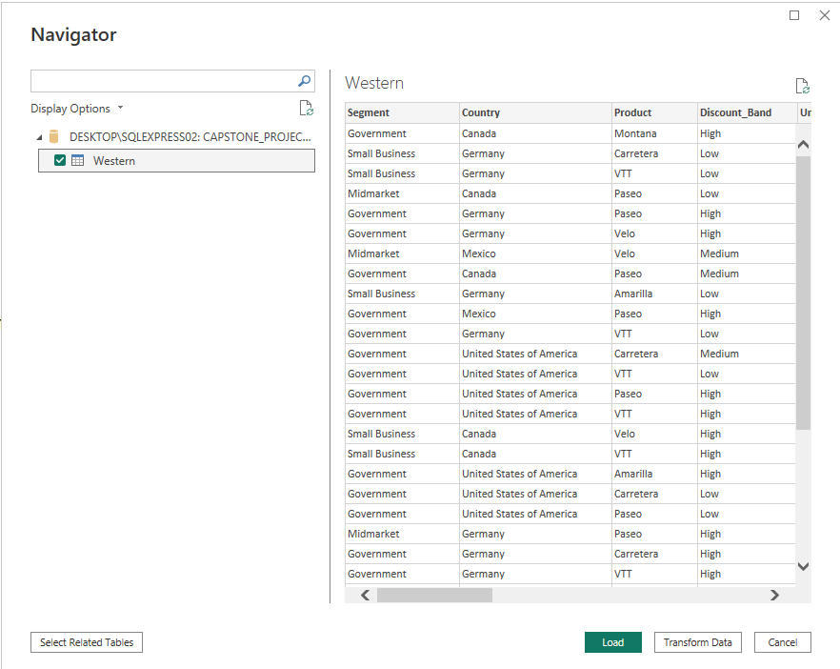
Import the Data from the SQL Database into PowerBI
Imported data from SQL Server and Created 4 KPI Measures.

Slide 8
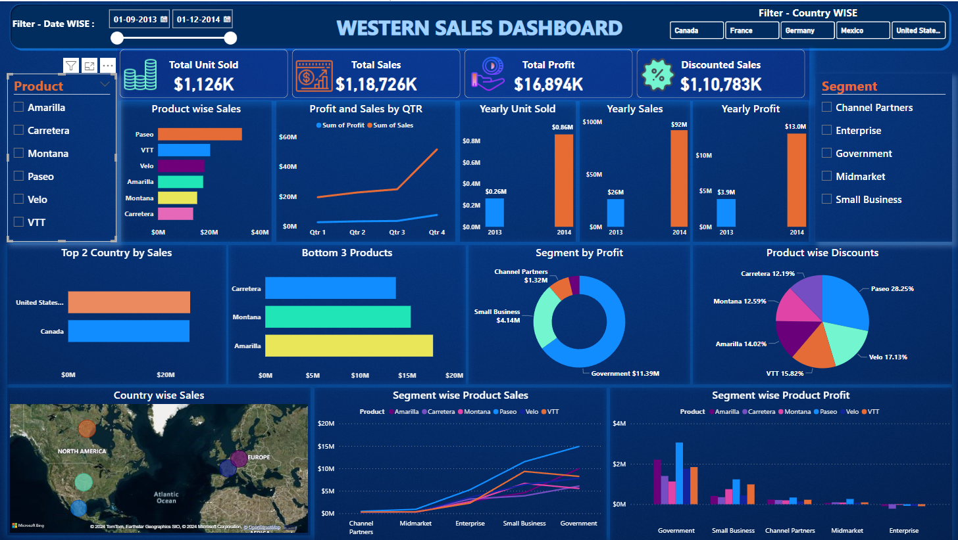
Interactive Dashboard by using visualization tools

Slide 9
Conclusion and Inferences
Detailed analysis using SQL, Excel, and Power BI revealed valuable insights on sales, profits, discounts, and trends across segments, products, and countries.
The interactive dashboard allows stakeholders to filter data by date, country, product, and segments, providing a user-friendly interface for informed decision-making.
Business Analytics techniques applied in this project demonstrate their practical utility in driving business growth and efficiency.
The project underscores the significance of data-driven decision-making for optimizing business strategies and maximizing profitability.
Overall, the comprehensive analysis and interactive dashboard empower stakeholders to make data-driven decisions effectively, enhancing organizational performance and competitiveness.
FOUNDS:
Top county with highest sales in USA.
Lowest sales by Carretera.
Government segment achieved highest profit of $11.39 million.
Product offering highest discount is Paseo with 28.25%.
Overall, performance in 2014 outperformed 2013.

Slide 10
Endnotes
In this project, we harnessed the power of data using SQL, Excel, and Power BI to unlock insights and drive business growth.
Through an interactive dashboard, stakeholders can now navigate sales, profits, and trends effortlessly, paving the way for smarter decision-making and enhanced profitability.

